Slide 1
Power System Fault Detection and Classification using machine learning
CAPSTONE PROJECT
Presented By:
JAIVARDHAN – RSD College – Computer Applications

Slide 2
OUTLINE
Problem Statement
Proposed Solution
System Development Approach
Algorithm & Deployment
Result (Output Image)
Conclusion
Future Scope
References

Slide 3
Problem Statement
Design a machine learning model to detect and classify different types of faults in a power distribution system. Using electrical measurement data (e.g., voltage and current phasors), the model should be able to distinguish between normal operating conditions and various fault conditions (such as line-to-ground, line-to-line, or three-phase faults). The objective is to enable rapid and accurate fault identification, which is crucial for maintaining power grid stability and reliability.

Slide 4
Proposed Solution
The proposed system aims to address the challenge of accurately detecting and classifying faults in a power distribution system using machine learning. The objective is to enable rapid identification of fault types to support grid stability and minimize downtime. The solution was implemented using IBM Cloud’s Watson Studio and leverages automated machine learning features.
Data Collection:
Gather historical and simulated electrical measurement data, including voltage and current phasors under both normal and faulty operating conditions.
Data Preprocessing:
Clean and preprocess the collected data to handle missing values, outliers, and inconsistencies.
Normalize and standardize features such as voltage magnitude, current phasors and power angle. Label the data.
Machine Learning Model Development
Use IBM Watson Studio’s AutoAI capability to automatically select and train optimal classification algorithms.
Evaluate multiple models based on performance metrics.
Deployment:
Develop the trained model as a REST API endpoint on IBM Cloud.
Integrate the endpoint with applications for real-time or batch fault detection.
Evaluation:
Assess model accuracy, precision, recall and F!-score using confusion matrix and cross validation.
Select the best performing model for deployment.

Slide 5
System Approach
The goal of this project is to detect and classify different types of electrical faults in a power distribution system using machine learning. The strategy involves automating model development using IBM Watson Studio's Auto AI feature, ensuring high accuracy with minimal manual intervention.
System requirements :
1. IBM Cloud account with access to Watson Studio.
2. Dataset containing voltage and current phasor measurements under normal and faulty conditions.
Library required to build the model
1. AutoAI (IBM Watson Studio) – for automated model building and optimization.
2. Watson Machine Learning Service – for deployment and API generation.

Slide 6
Algorithm & Deployment
Algorithm Selection
Random Forest Classifier (or SVM based on performance)
Data Input:
Voltage, current and phasor measurements from dataset.
Training Process:
Supervised learning using labelled fault types.
Prediction Process:
Model deployed on IBM Watson Studio with API endpoints for real time predictions.

Slide 7
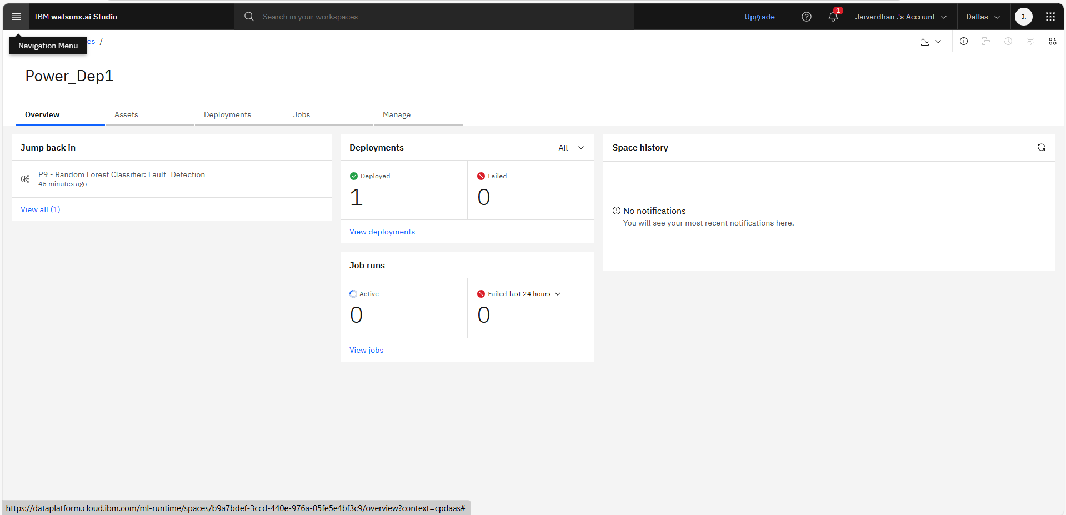
Result

Slide 8
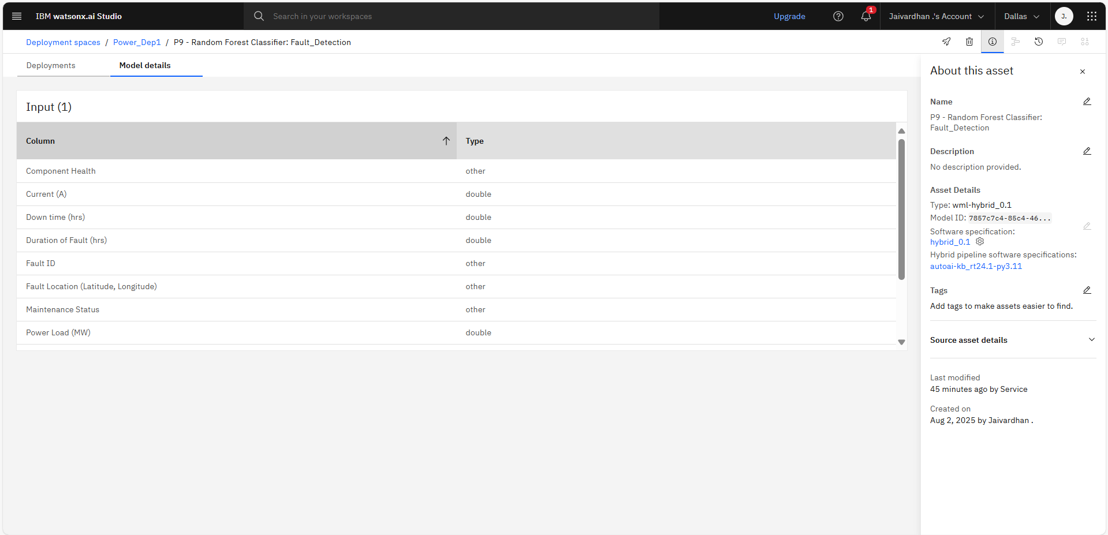
Result

Slide 9
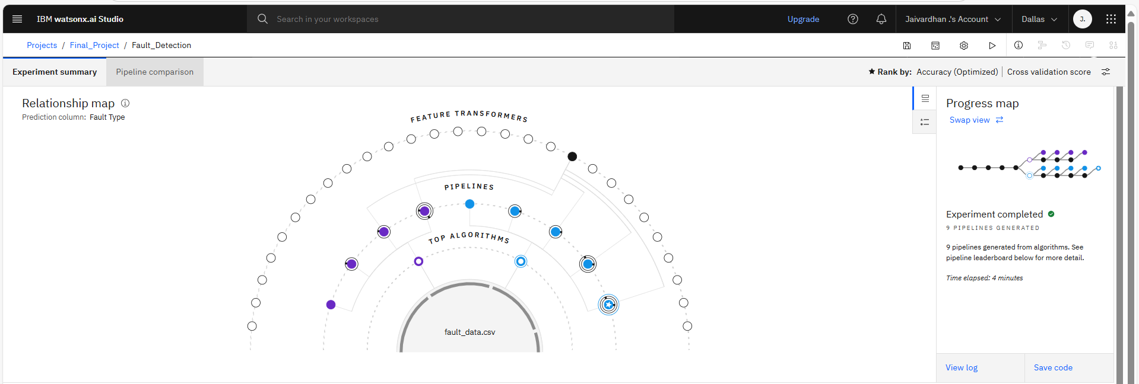
Result

Slide 10
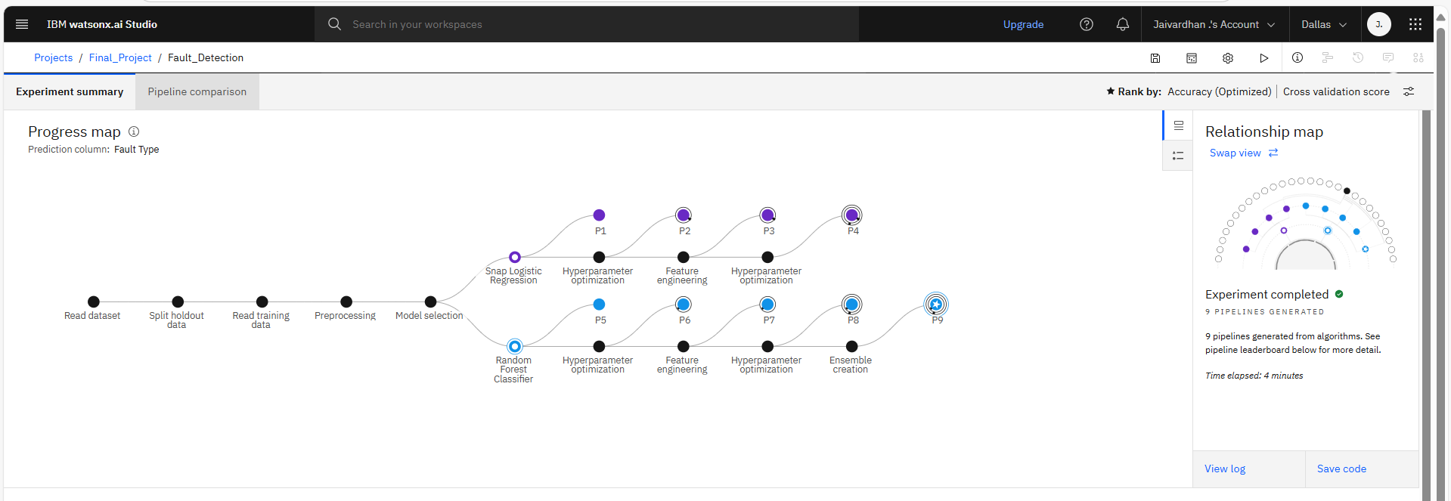
Result

Slide 11
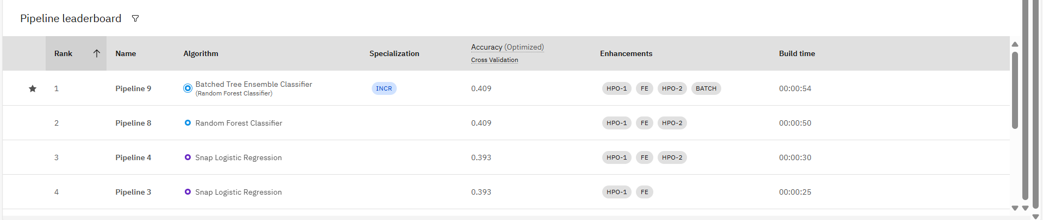
Result

Slide 12
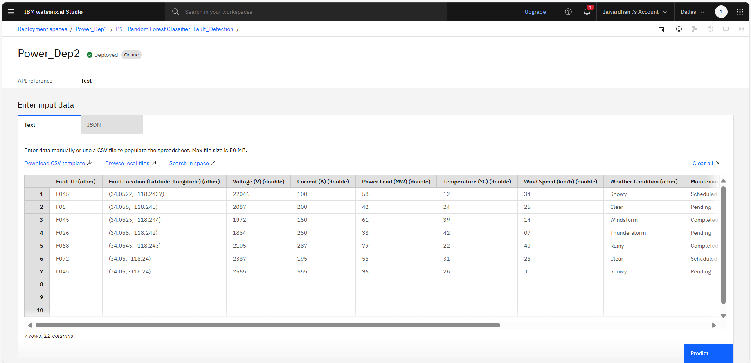
Result

Slide 13
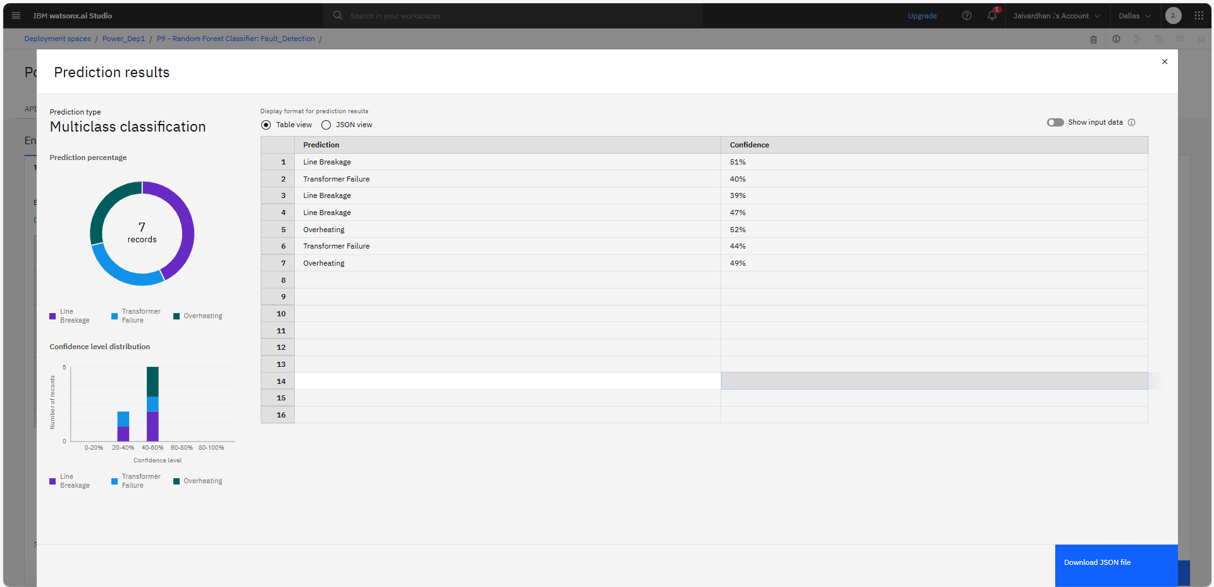
Result

Slide 14
Conclusion
This project successfully demonstrates the use of machine learning for accurate fault detection and classification in power distribution systems. Leveraging IBM Watson Studio’s Auto AI, the model efficiently identified normal and faulty conditions—including line-to-ground, line-to-line, and three-phase faults—using electrical measurement data. The automated approach proved effective in reducing development time while achieving high accuracy. Deploying the model on IBM Cloud enabled real-time fault detection, contributing to faster response and improved grid reliability. Some challenges were encountered during data preprocessing, feature selection, and managing cloud-based resources. However, Watson Studio’s tools helped address these issues efficiently. Overall, the model plays a vital role in enhancing the stability and safety of the power grid, demonstrating the value of AI in modern energy infrastructure.

Slide 15
Future scope
Additional Data Sources
Incorporate real-time sensor data, smart meters, and weather information to enhance prediction accuracy.
Algorithm Optimization
Use advanced ML techniques like deep learning or ensemble methods for better fault classification.
Geographical Expansion
Scale the system to cover multiple cities or regions with varied grid conditions.
Edge Computing Integration
Deploy models on edge devices for faster, on-site fault detection with minimal latency.
Advanced ML Integration
Explore transfer learning or federated learning to improve adaptability and data privacy.

Slide 16
References
IBM Cloud Docs – Auto AI Overview and Usage Guide
IBM Watson Studio – Getting Started with Watson Studio
Scikit-learn – Machine Learning in Python
IBM Developer – Building and Deploying ML Models on IBM Cloud

Slide 17
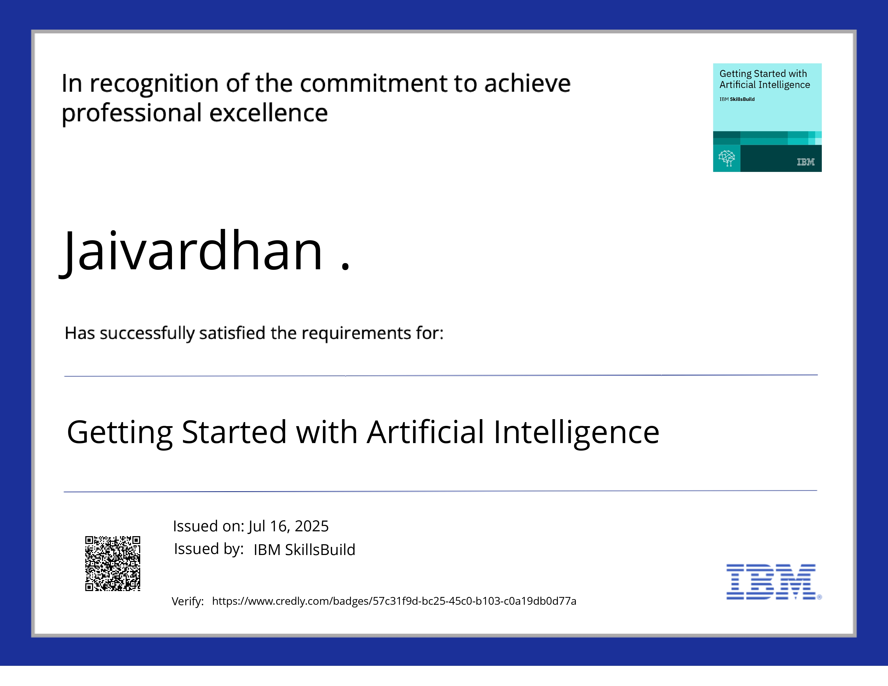
IBM Certifications

Slide 18
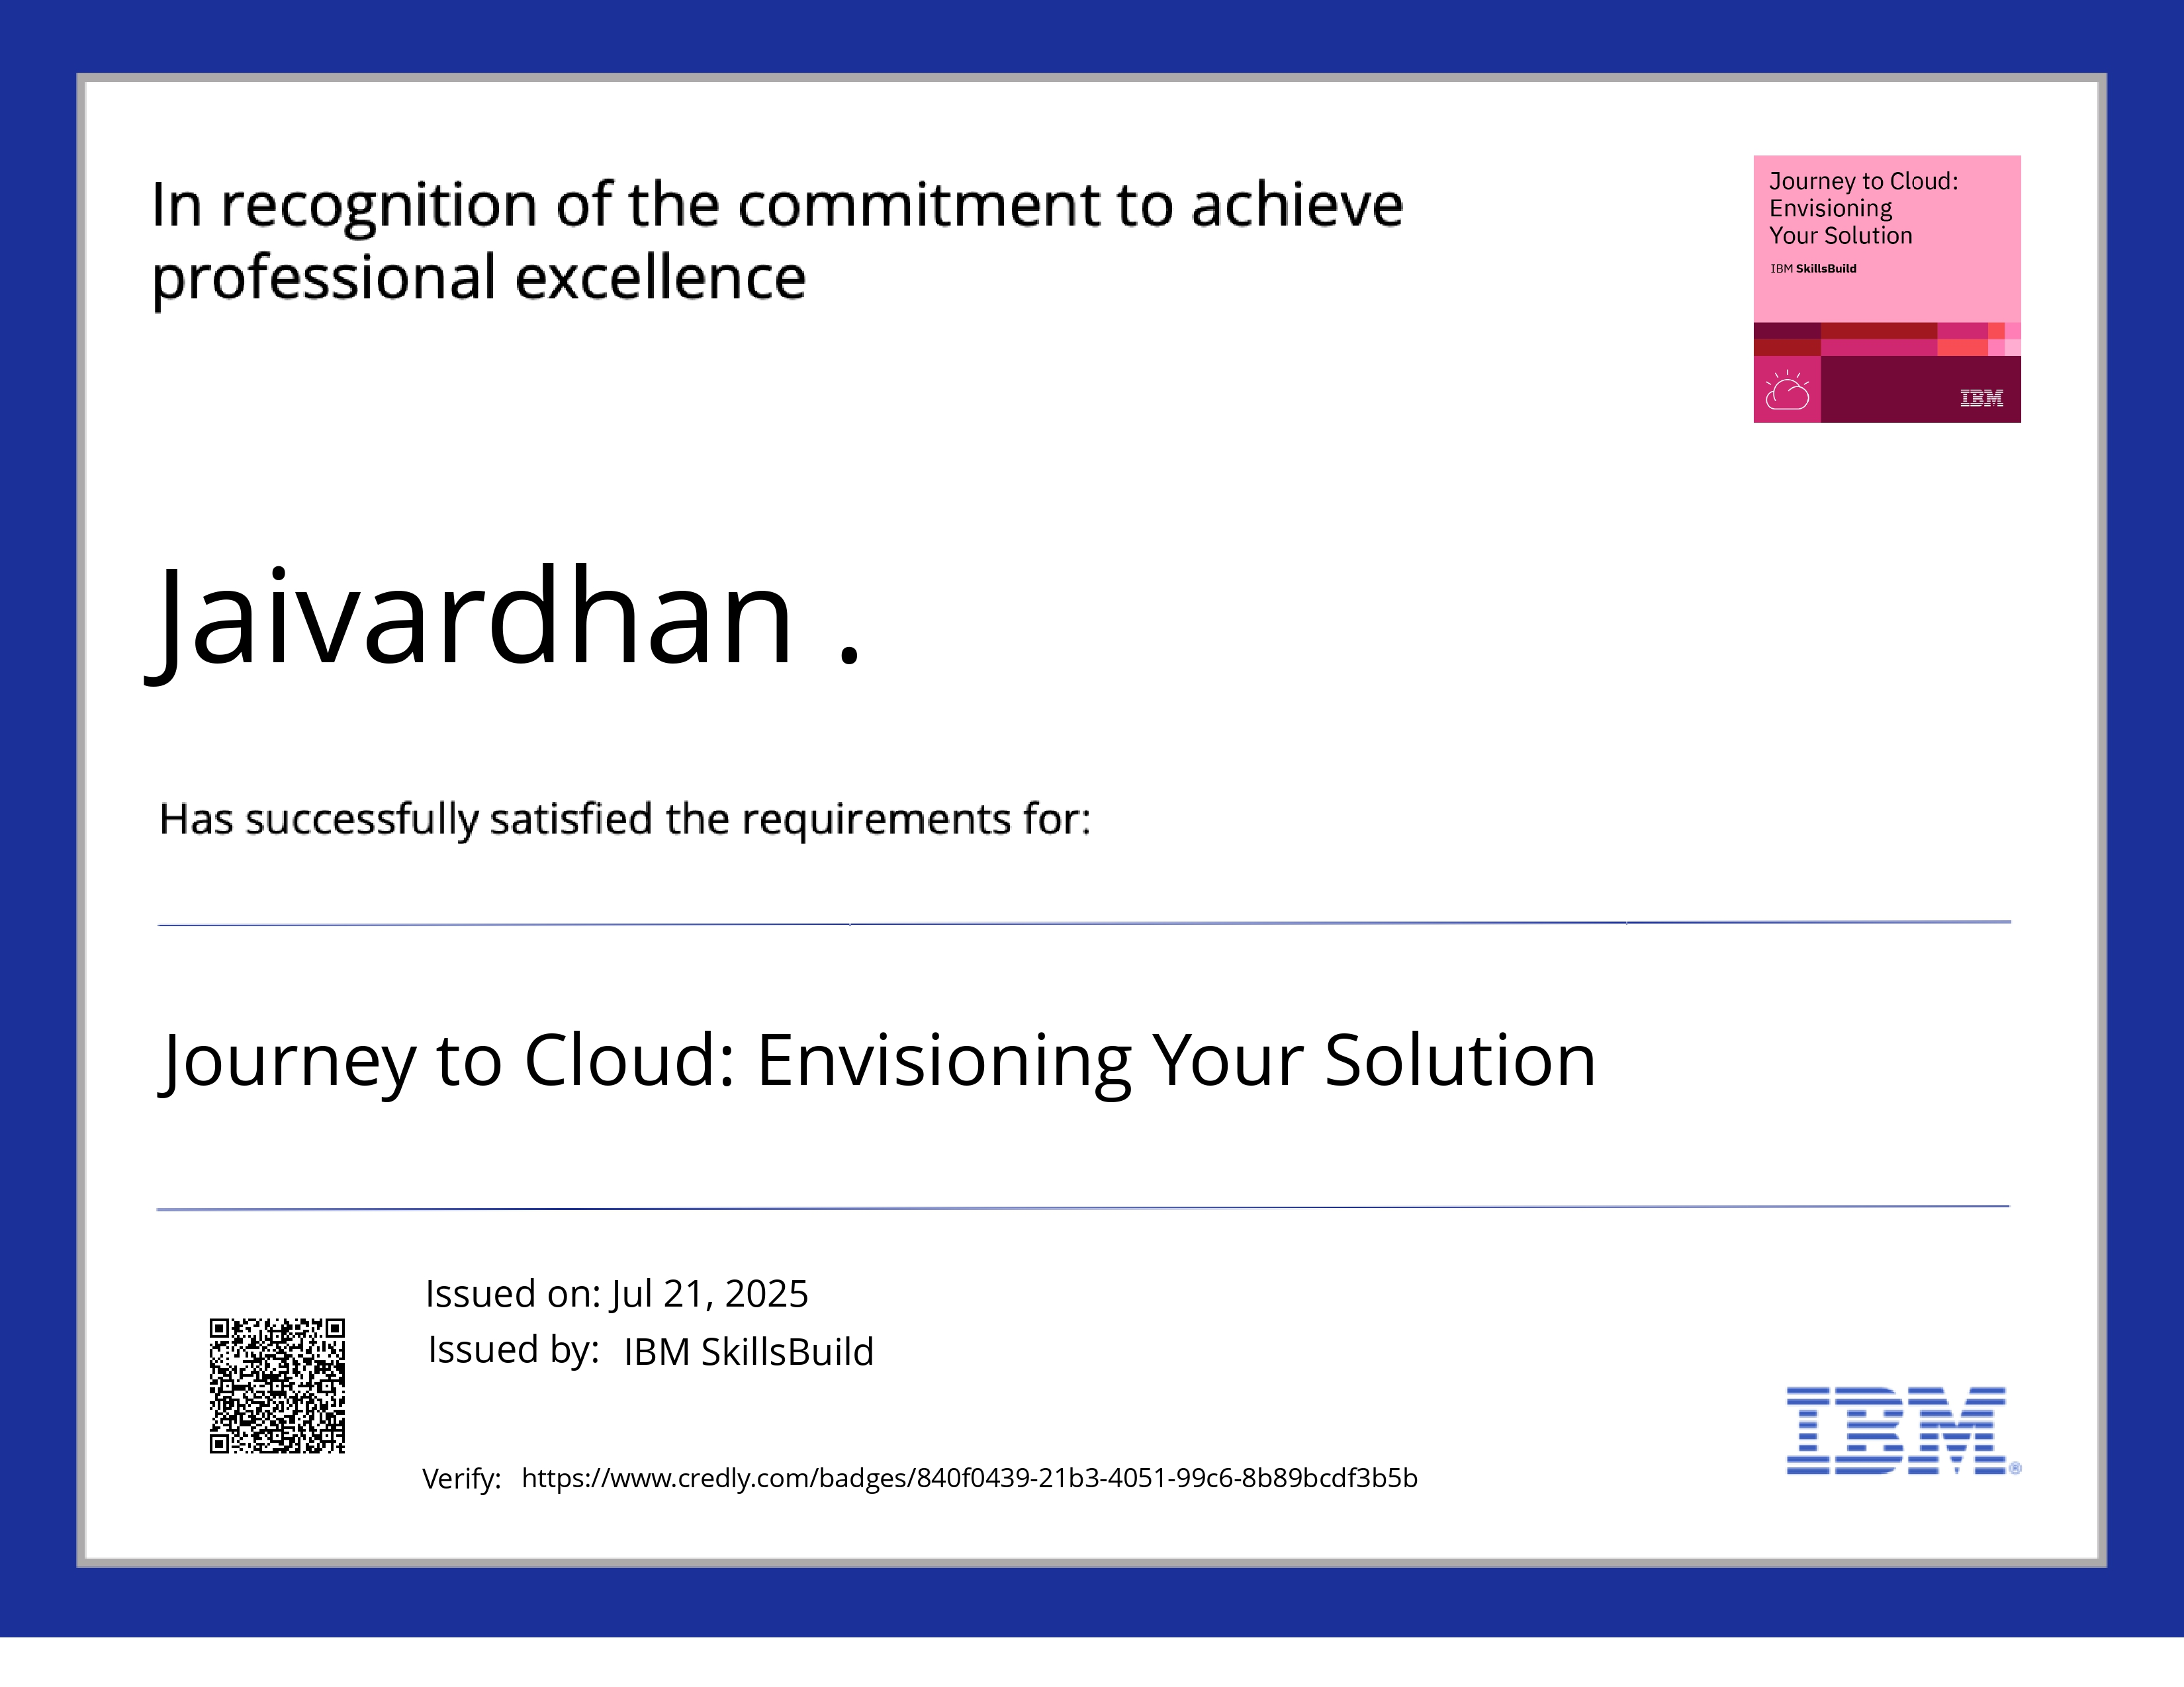
IBM Certifications

Slide 19
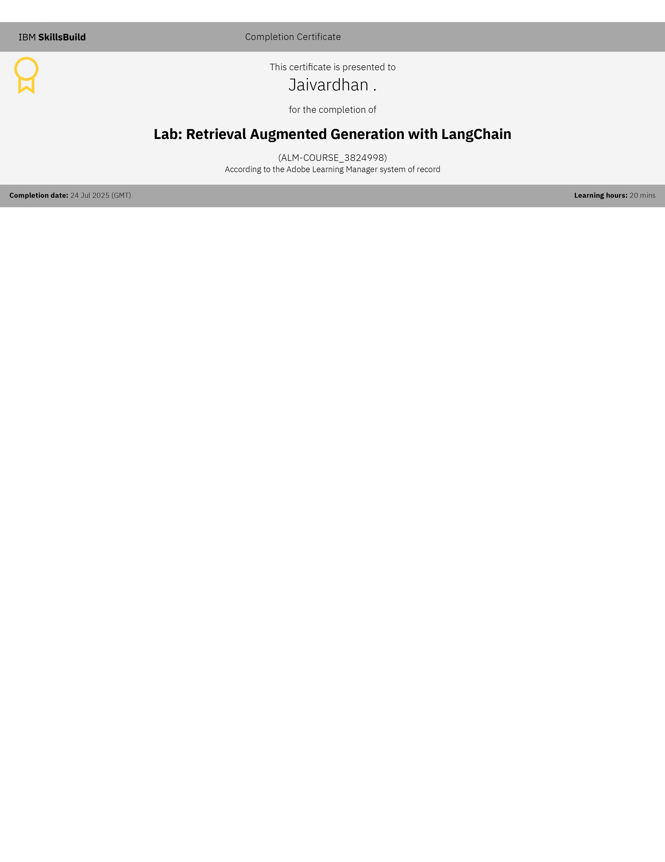
IBM Certifications

Slide 20
THANK YOU

